Slide 1
Why Topological Data Analysis Beats Dimension Reduction

Slide 2
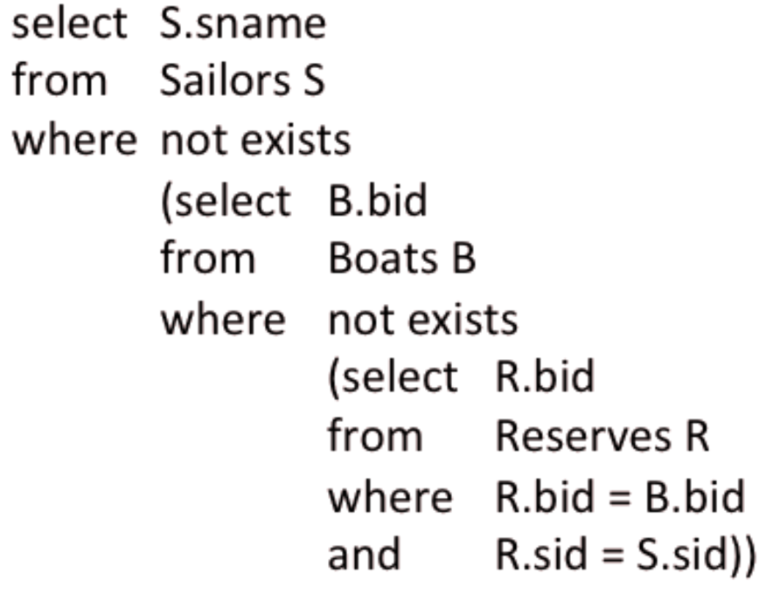
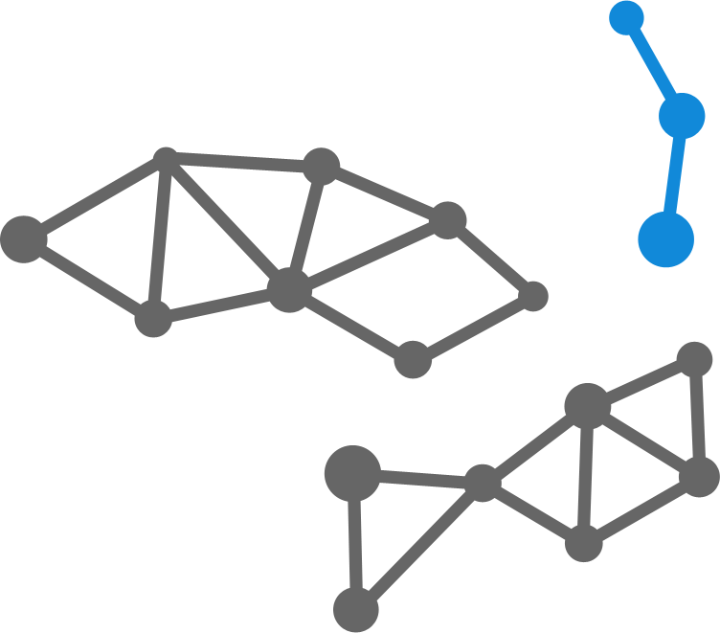
The motivation
+
Instead of asking data specific questions we can use traditional tools to join different data sources and prepare a holistic dataset
This dataset can be automatically processed using topological data analysis and presented as map of dependencies and correlations
=
Get answers to questions you didn’t ask yet

Slide 3
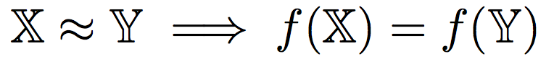


Topological invariants
A topological invariant is a map f that assigns the same object to
homeomorphic spaces, that is:
Homology: is a machine that converts local data about a space into global algebraic structure
Reference: Wikipedia, 2010.

Slide 4
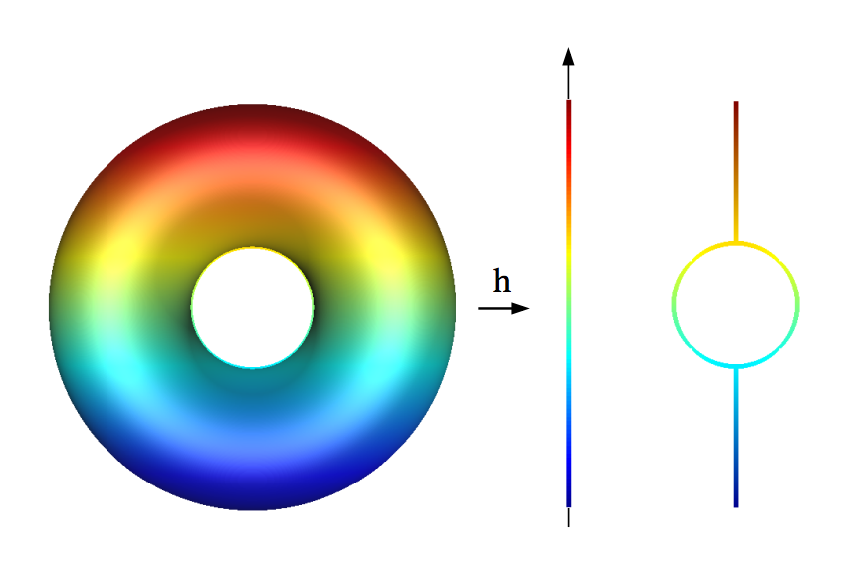
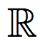
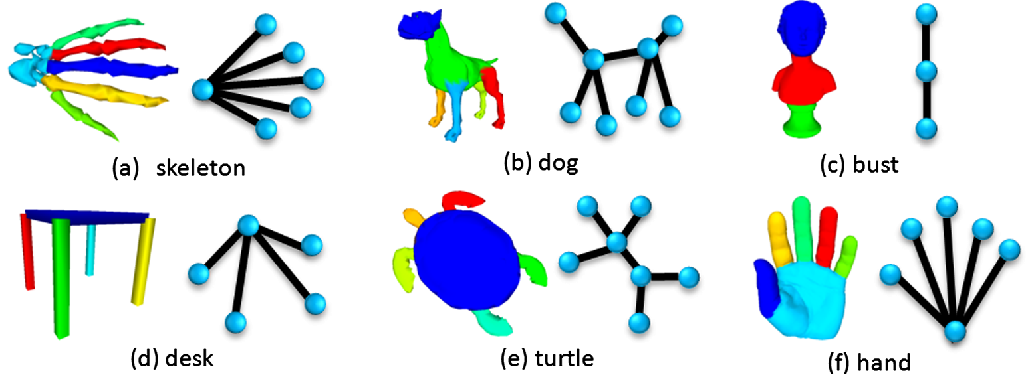
Morse Theory and Reeb Graph
Theorem:
Suppose h : X g is a discrete Morse function.
Then X is homotopy equivalent to a CW-complex with exactly one cell of dimension p for each critical simplex of dimension p.
Reference: Teng Ma ; Zhuangzhi Wu ; Pei Luo ; Lu Feng. Reeb graph computation through spectral clustering, 2011.

Slide 5

Case study: Netflix competition
A dataset from Netflix open competition best collaborative filtering algorithm to predict user ratings for films:
100,480,507 ratings
480,189 users
17,770 movies
2.1 GB of CSV file

Slide 6
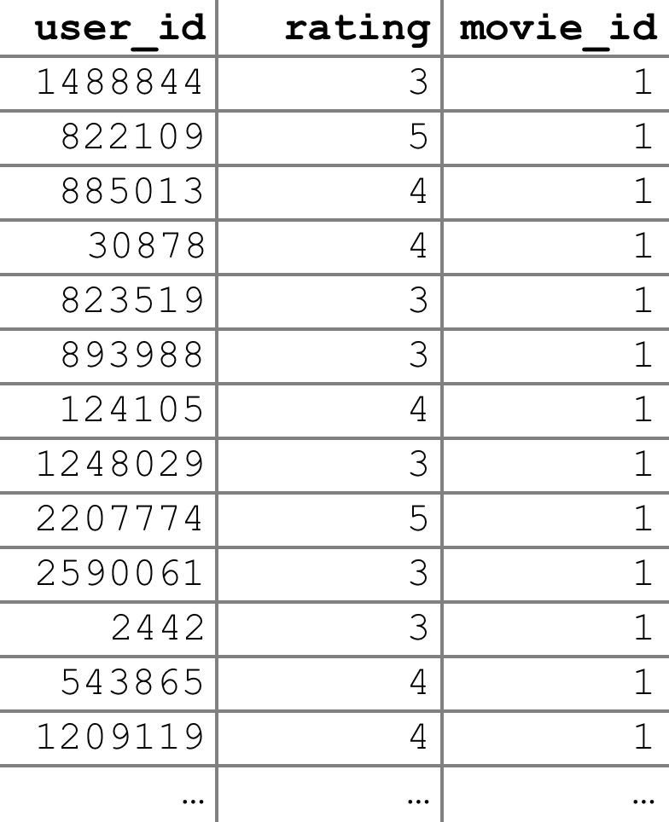
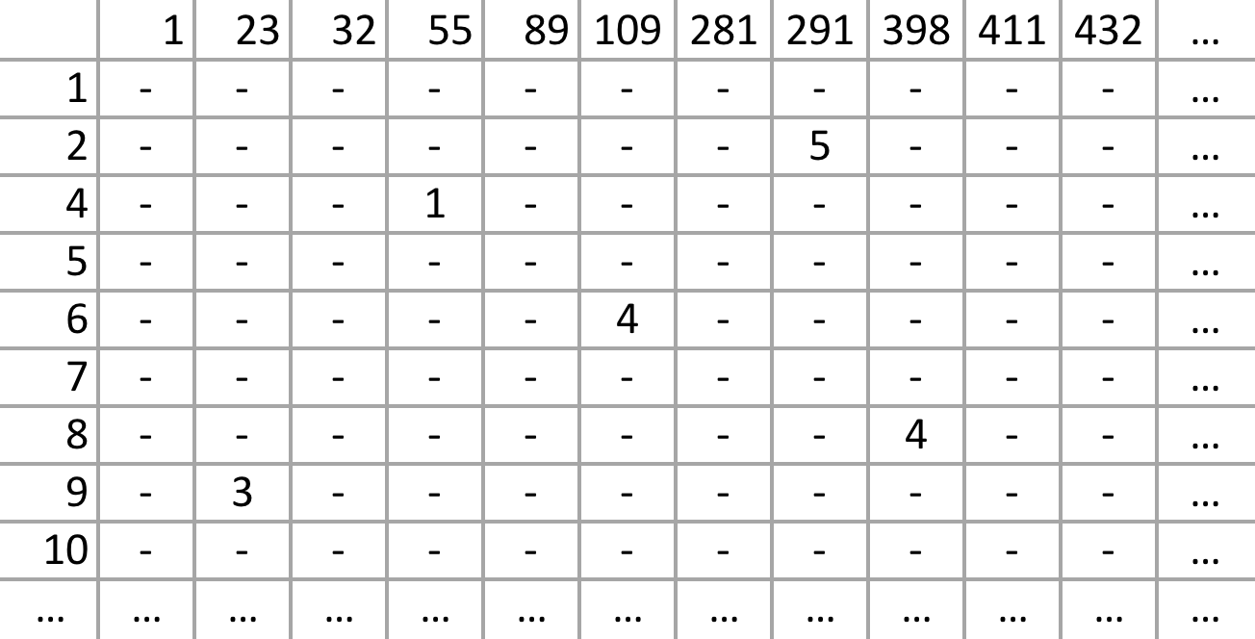
Case study: Netflix competition
Data Transformation
Source data
Data format for TDA
users
movies
[100,480,507:3]
300 millions of elements
[17,770:480,189]
8.5 billions of elements

Slide 7
Case study: Netflix competition
Data Transformation
Challenges:
During pivoting we’re transforming 300 millions of data items into 8.5 billions of data items, which require more than 200 GB of ram
My current TDA algorithm implementation has O( log(n) ) computational and memory complexity, which makes it even more complicated to compute as is

Slide 8
Case study: Netflix competition
Data Transformation: the solution
Split dataset in buckets by range of movie_ids
…
Pivot each data bucket
(rows: movies, columns: users)
…
Learn PCA coefficients on random subset
Perform serial executions of PCA on each batch using previously learned PCA vectors
Merging batches in whole dataset

Slide 9
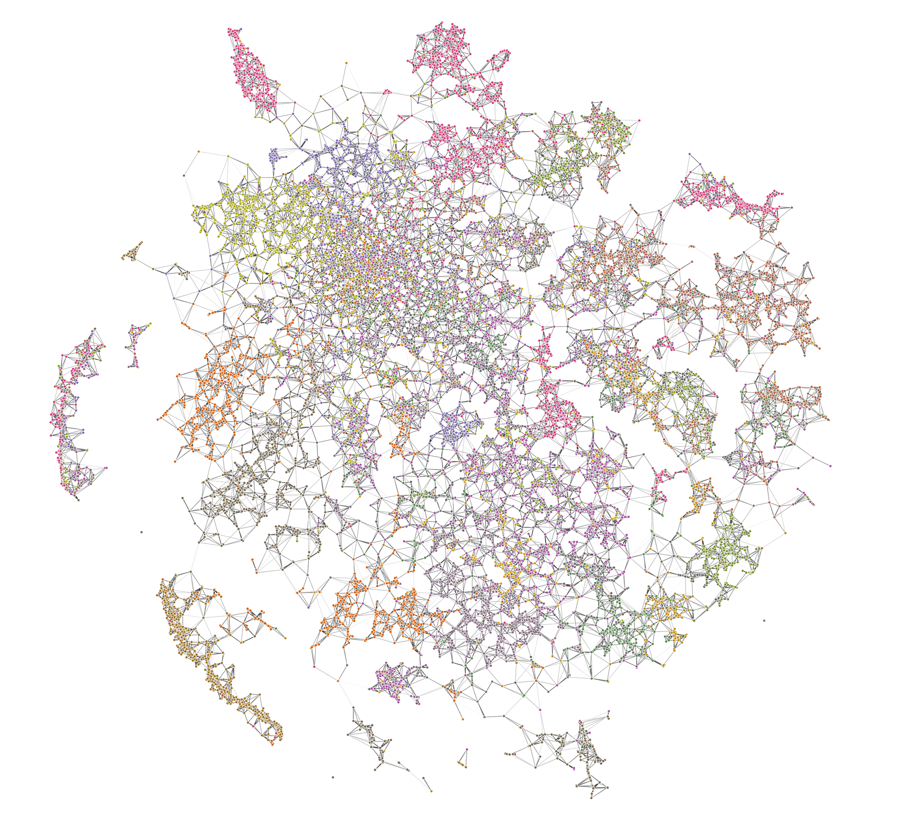
Case study: Netflix competition

Slide 10
Case study: Netflix competition
Indian
Honk Kong
Music
French
US
Retro
US Cartoons
German
Horror
Anime
Kids
Movie

Slide 11
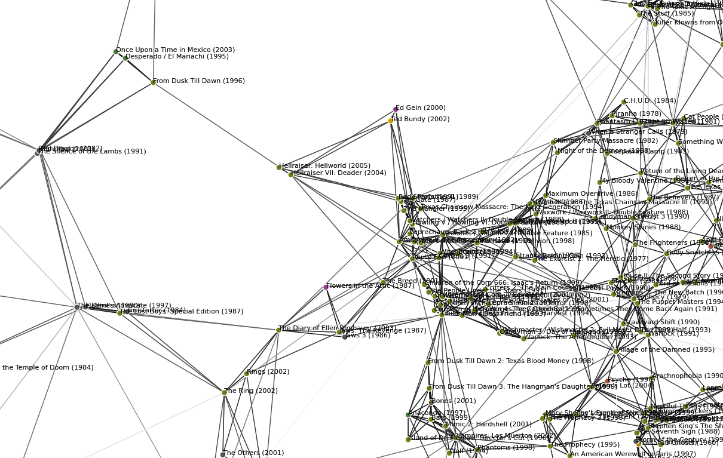
Case study: Netflix competition
Horror movies example

Slide 12
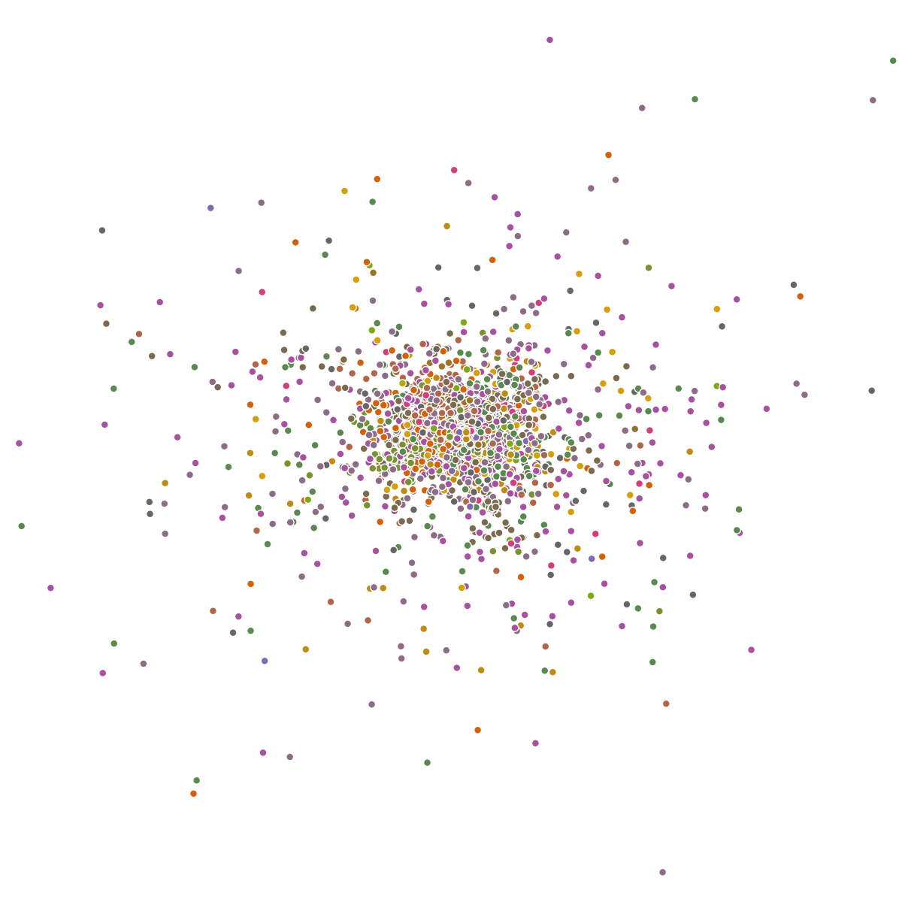
Case study: Netflix competition
Result comparison: PCA

Slide 13
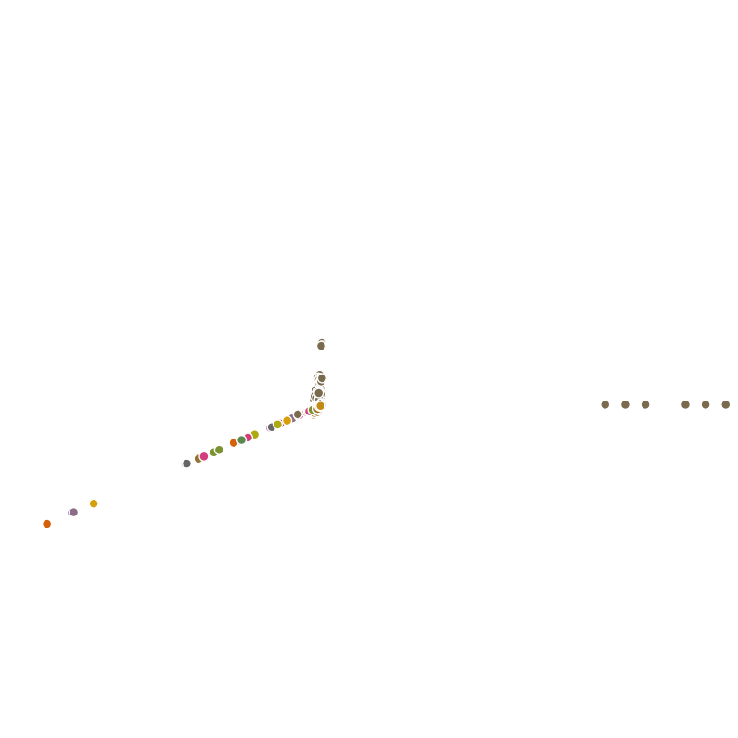
Case study: Netflix competition
Result comparison: Spectral Embedding

Slide 14
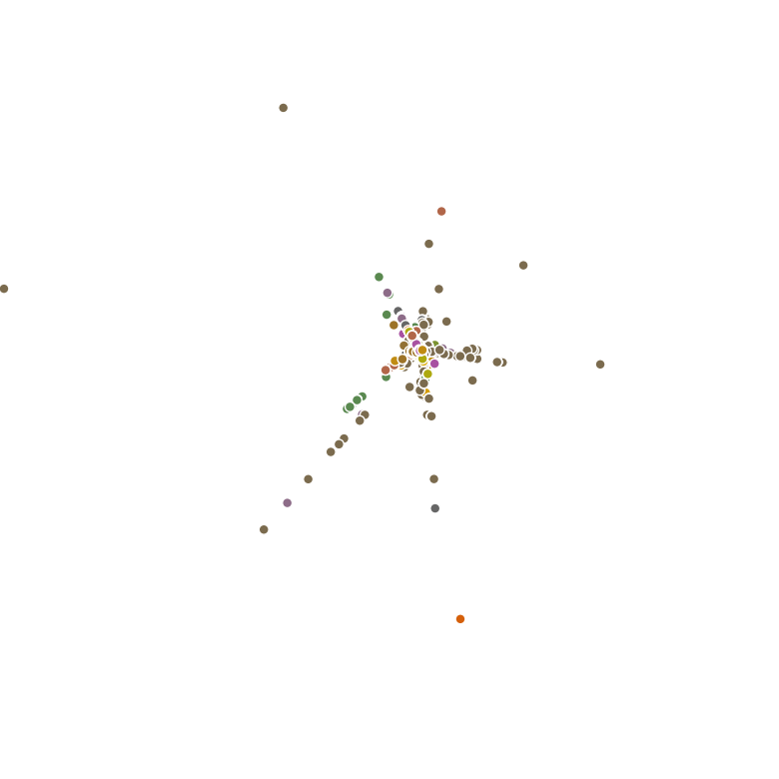
Case study: Netflix competition
Result comparison: Locally-linear embedding (LLE)

Slide 15
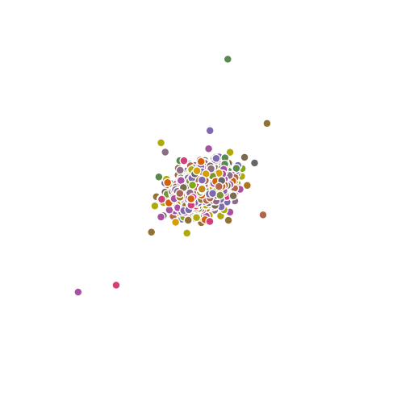
Case study: Netflix competition
Result comparison: Hessian LLE

Slide 16
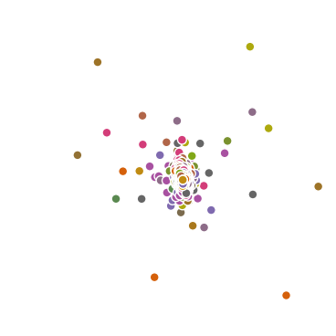
Case study: Netflix competition
Result comparison: Local tangent space alignment (LTSA)

Slide 17
Case study: Netflix competition
Result comparison: TDA with other techniques
Topological Data Analysis
LLE
LTSA
PCA
Hessian LLE
Spectral Embedding

Slide 18

Case study: Yelp Dataset Challenge
http://www.yelp.com/dataset_challenge
Sample of our data from the greater Phoenix, AZ metropolitan area including:
15,585 businesses
111,561 business attributes
11,434 check-in sets
70,817 users
151,516 edge social graph
113,993 tips
335,022 reviews

Slide 19
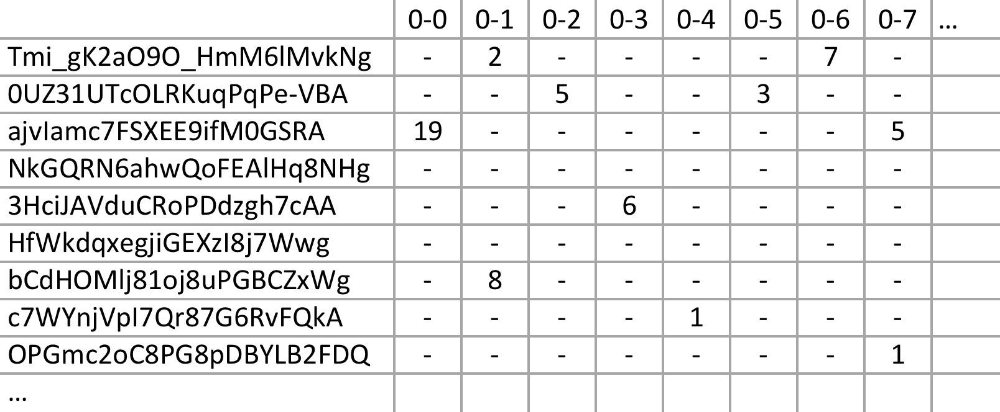
Case study: Yelp Dataset Challenge
Data Transformation
Check-ins
{
'type': 'checkin',
'business_id': (encrypted business id),
'checkin_info': {
'0-0': (number of checkins from 00:00 to 01:00 on all Sundays),
'1-0': (number of checkins from 01:00 to 02:00 on all Sundays),
...
'14-4': (number of checkins from 14:00 to 15:00 on all Thursdays),
...
'23-6': (number of checkins from 23:00 to 00:00 on all Saturdays)
}, # if there was no checkin for a hour-day block it will not be in the dict
}
[15,585:168]
2.6 millions of elements

Slide 20
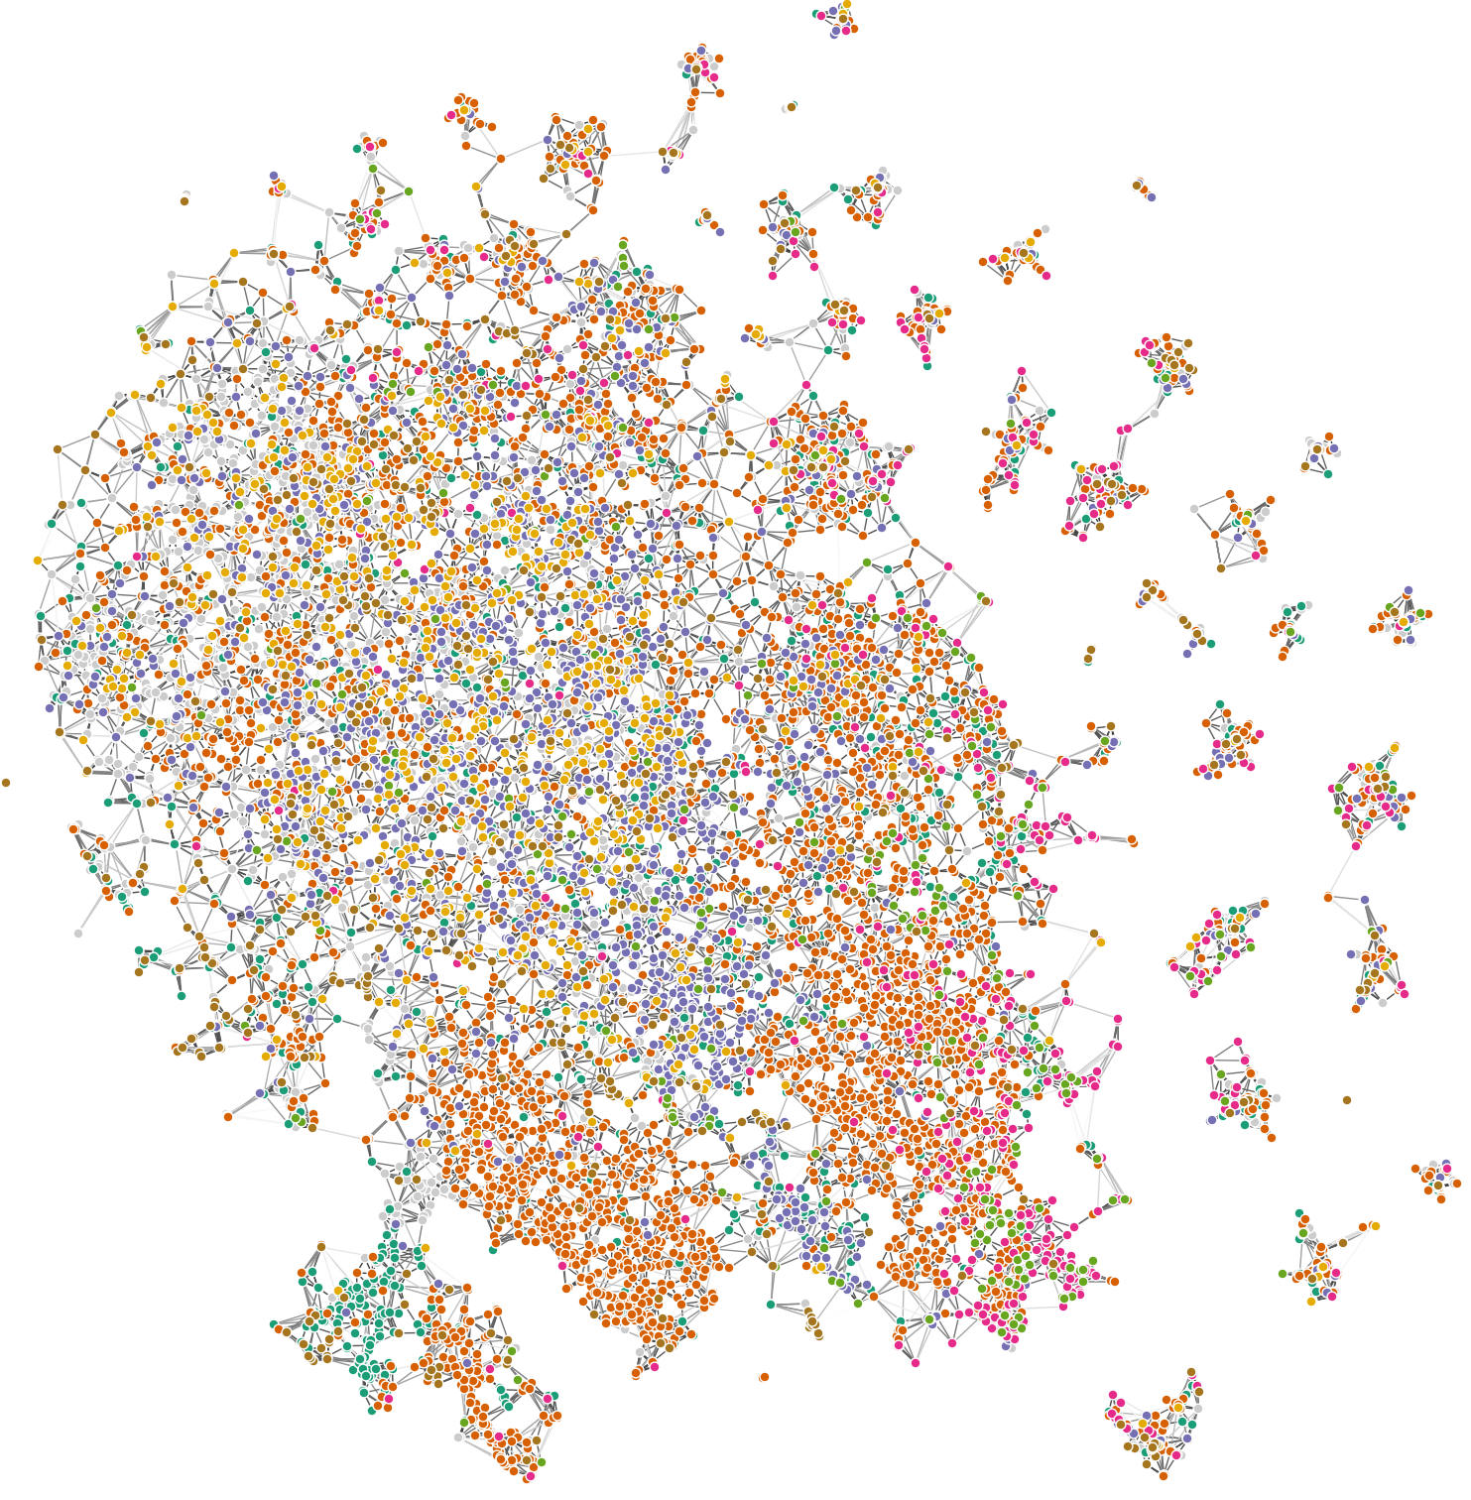
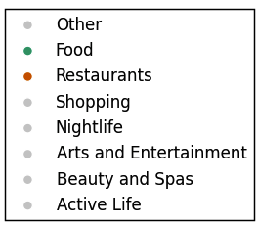
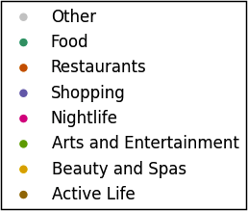
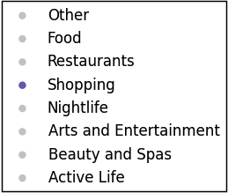
Case study: Yelp Dataset Challenge
Visualisation: All categories

Slide 21
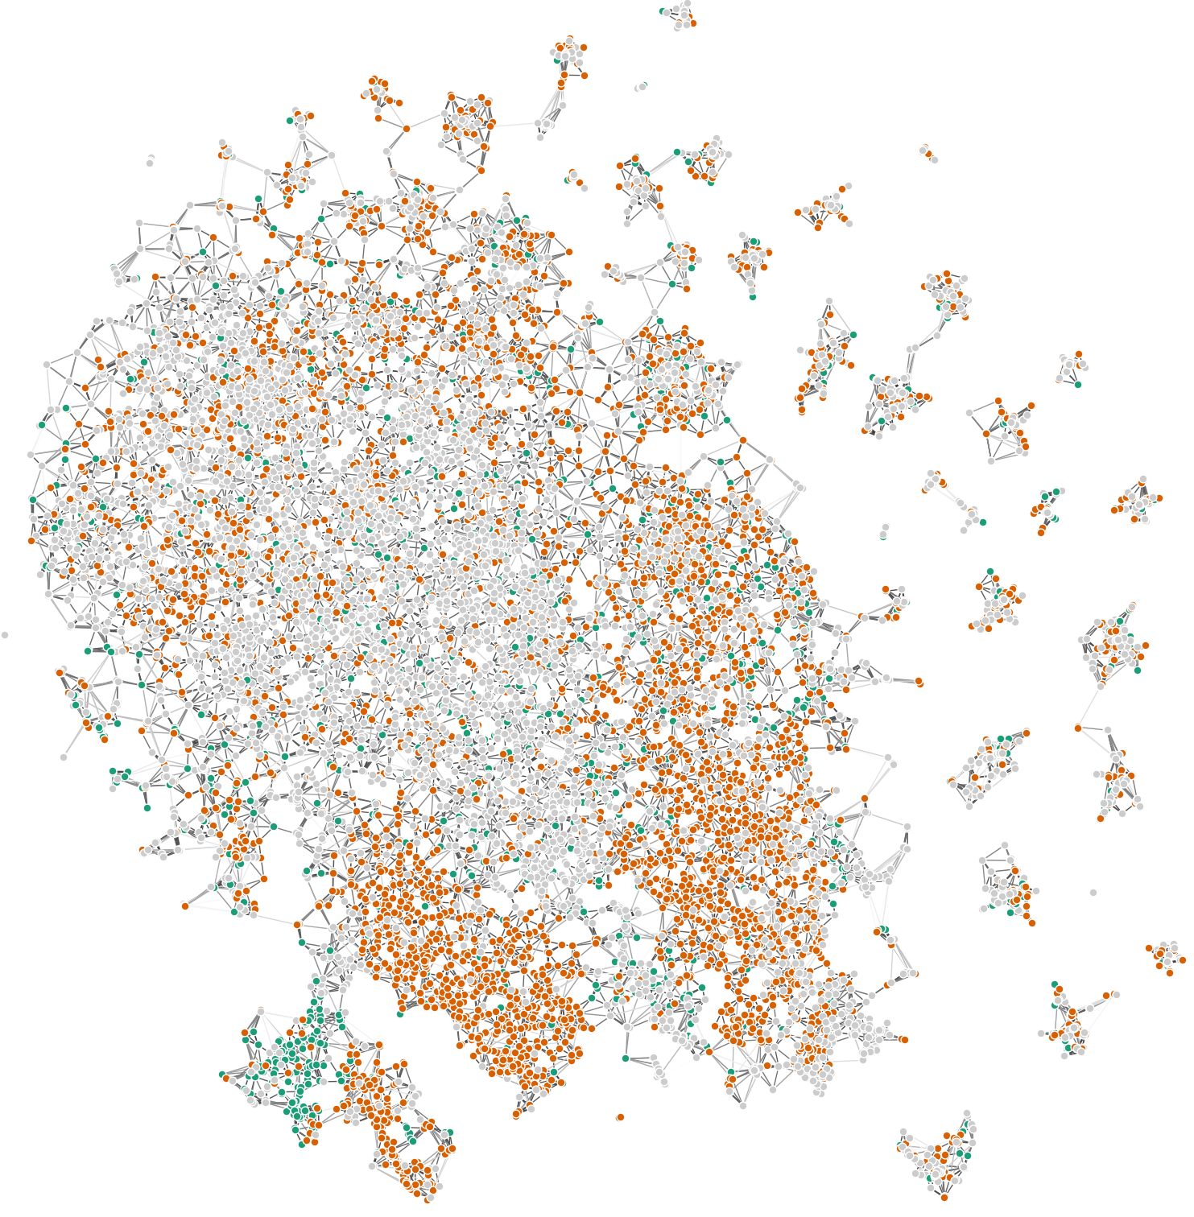
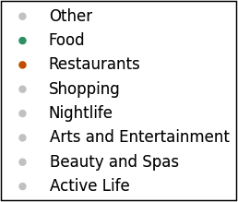
Case study: Yelp Dataset Challenge
Visualisation: Food, Restaurants

Slide 22
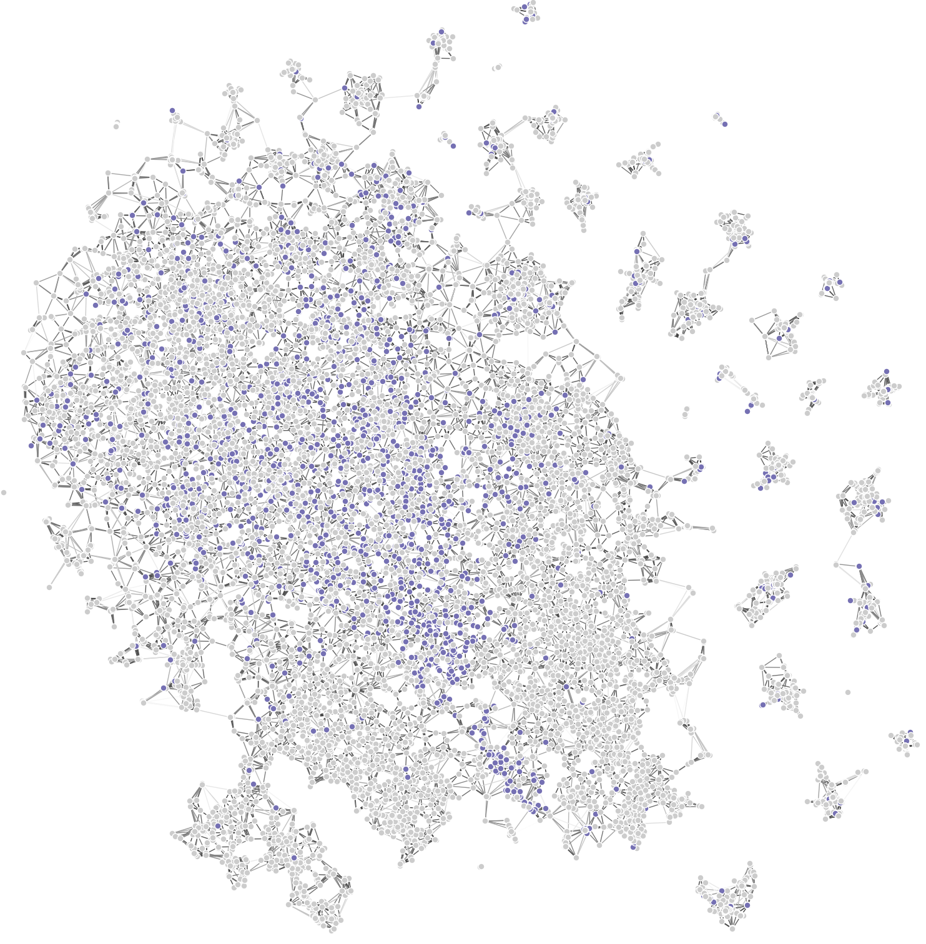
Case study: Yelp Dataset Challenge
Visualisation: Shopping

Slide 23
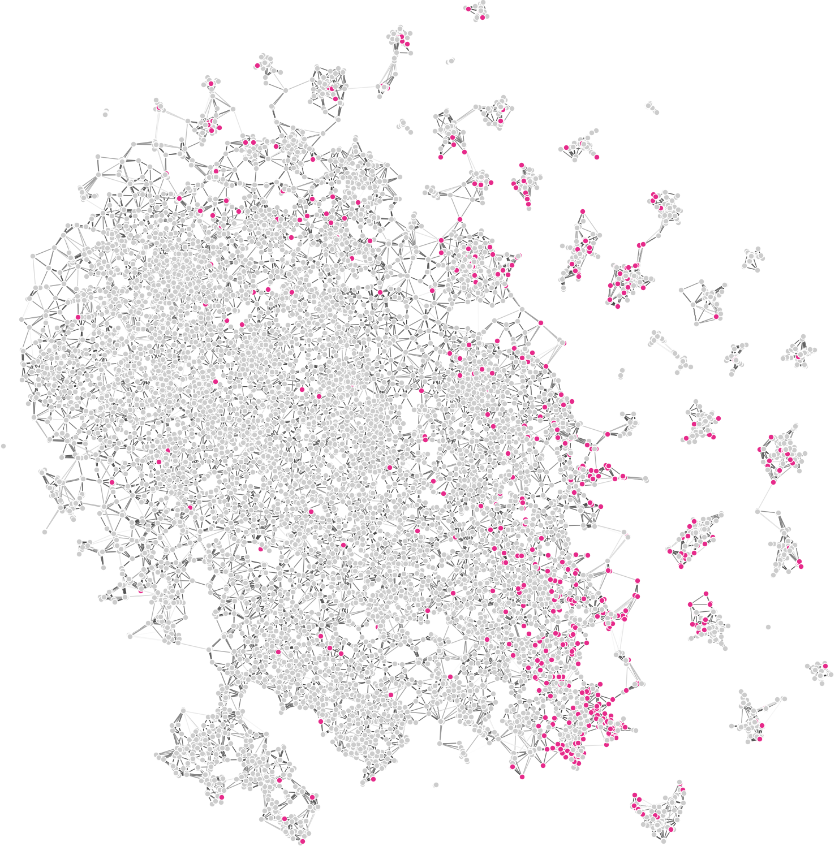
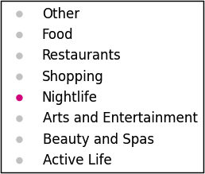
Case study: Yelp Dataset Challenge
Visualisation: Nightlife

Slide 24
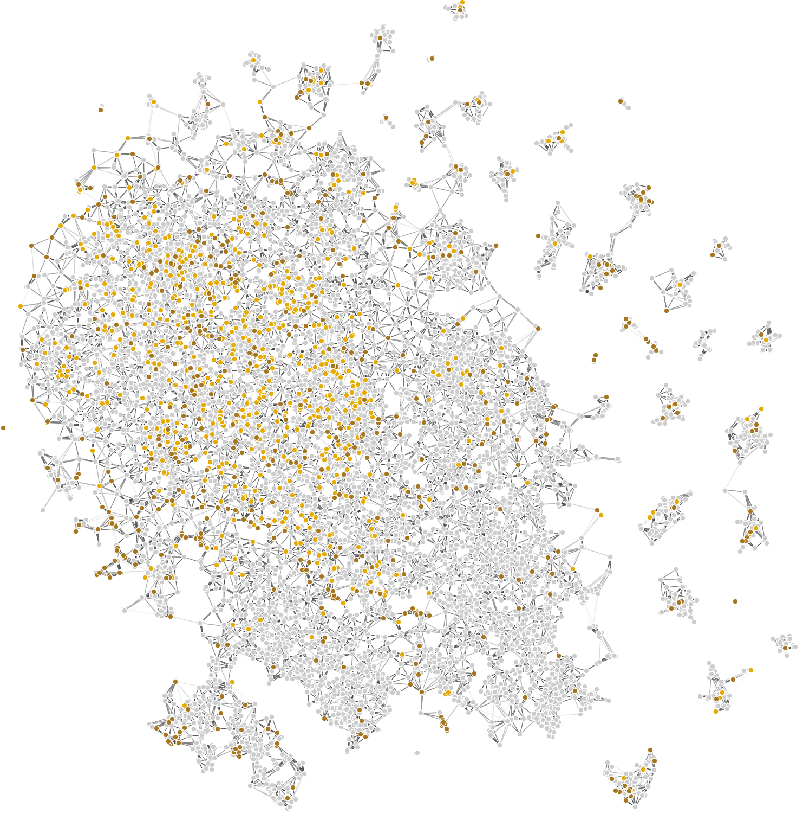
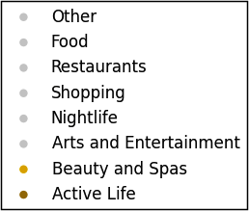
Case study: Yelp Dataset Challenge
Visualisation: Beauty & Spas, Active Life

Slide 25

Case study: Yelp Dataset Challenge
Visualisation: cluster examination
Cluster characteristics:
Tuesday, 2:00 is not NaN

Slide 26
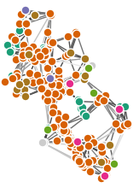
Case study: Yelp Dataset Challenge
Visualisation: cluster examination
Cluster characteristics:
More than 35 check-ins everyday at 10:00
Less than 17 check-ins everyday at 15:00
Most has category “Breakfast and brunch”

Slide 27
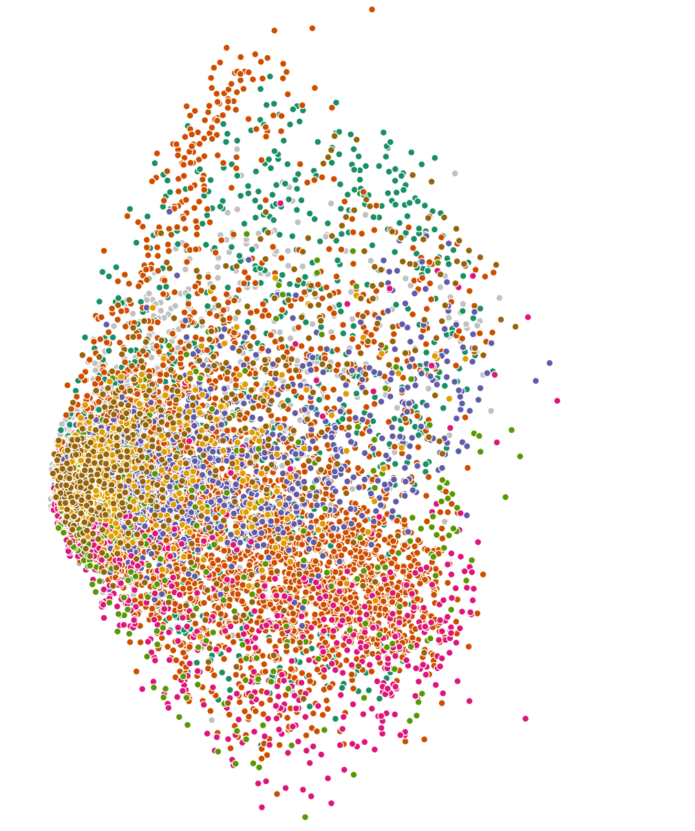
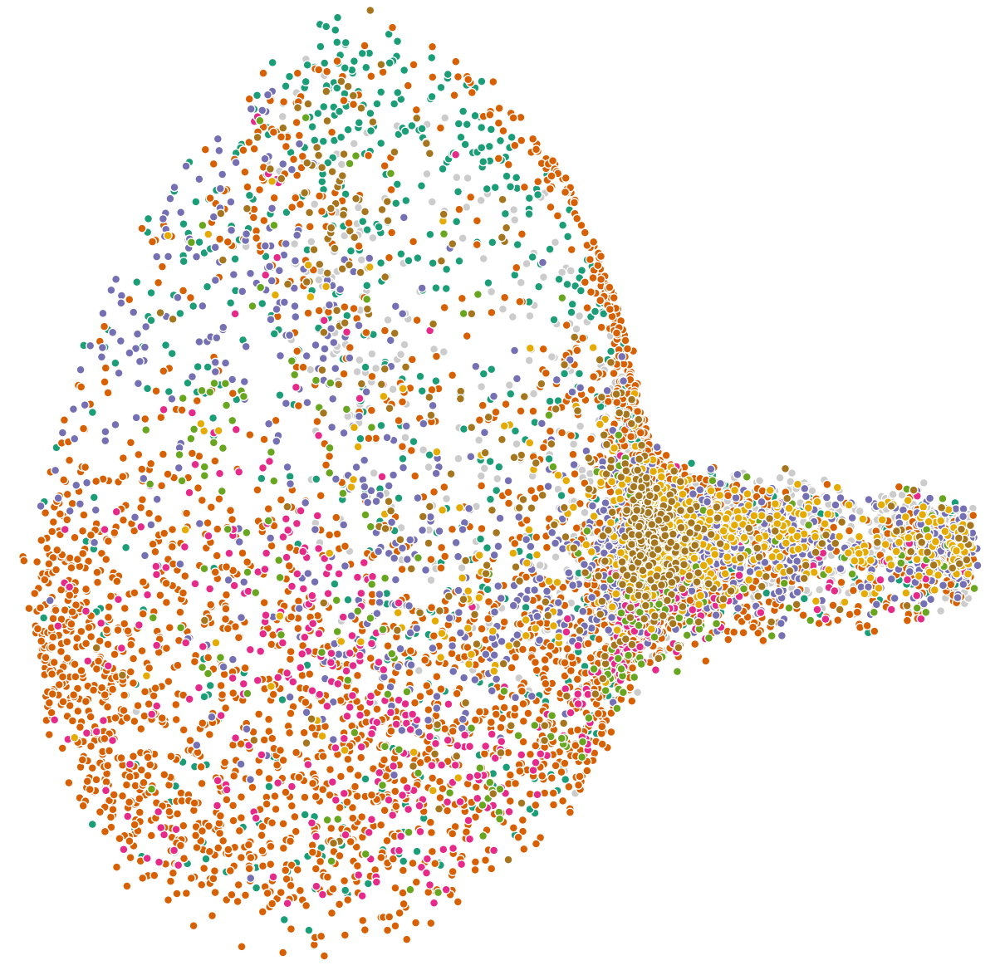
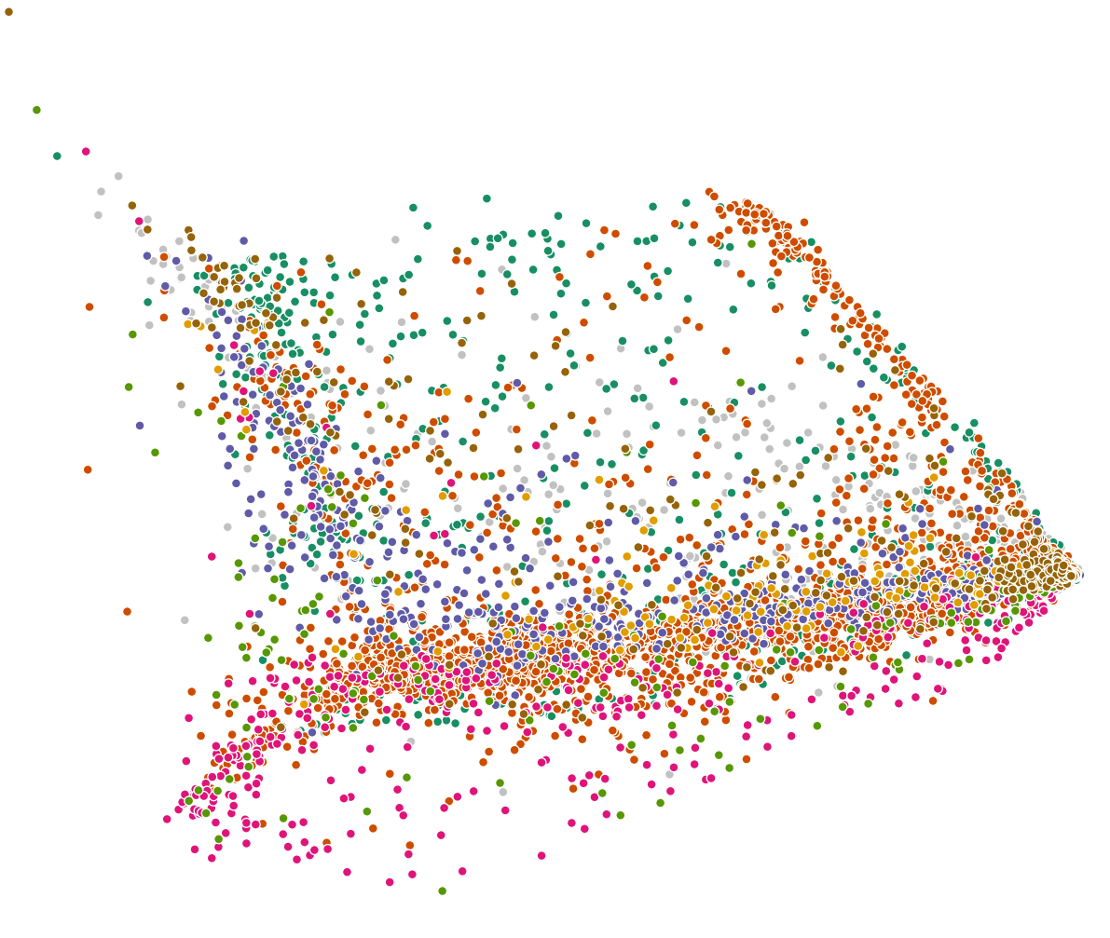
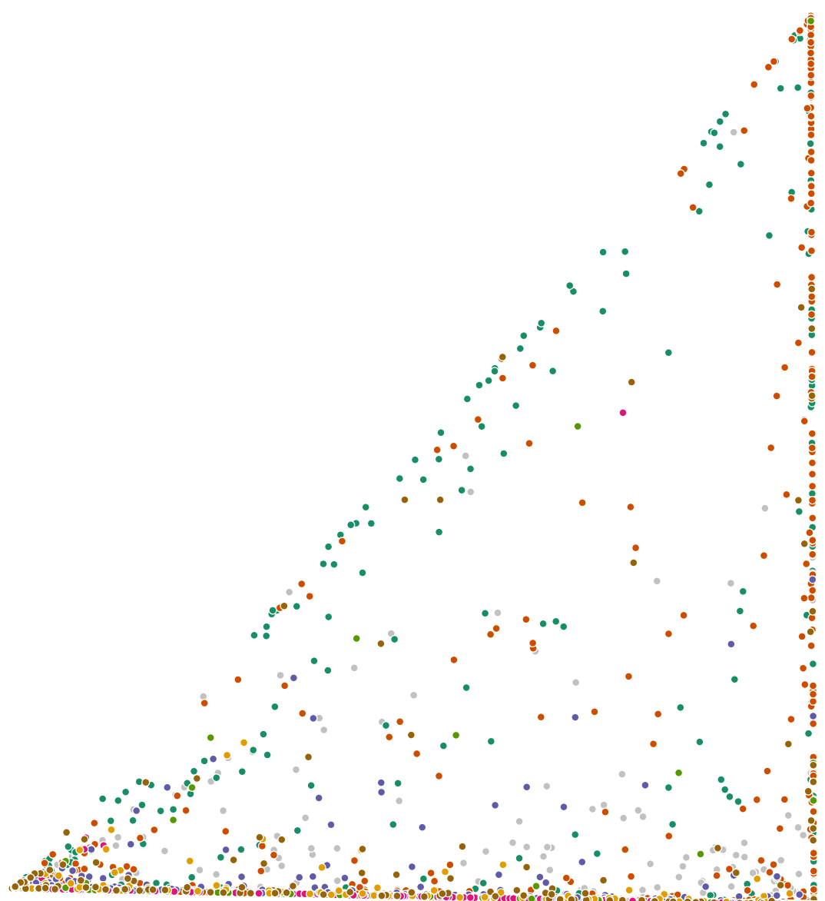
Case study: Yelp Dataset Challenge
Result comparison: TDA with other techniques
Spectral
Embedding
(806 sec)
Topological Data Analysis
(275 sec)
PCA
(0.19 sec)
Modified LLE
(1206 sec)
LLE
(366 sec)

Slide 28
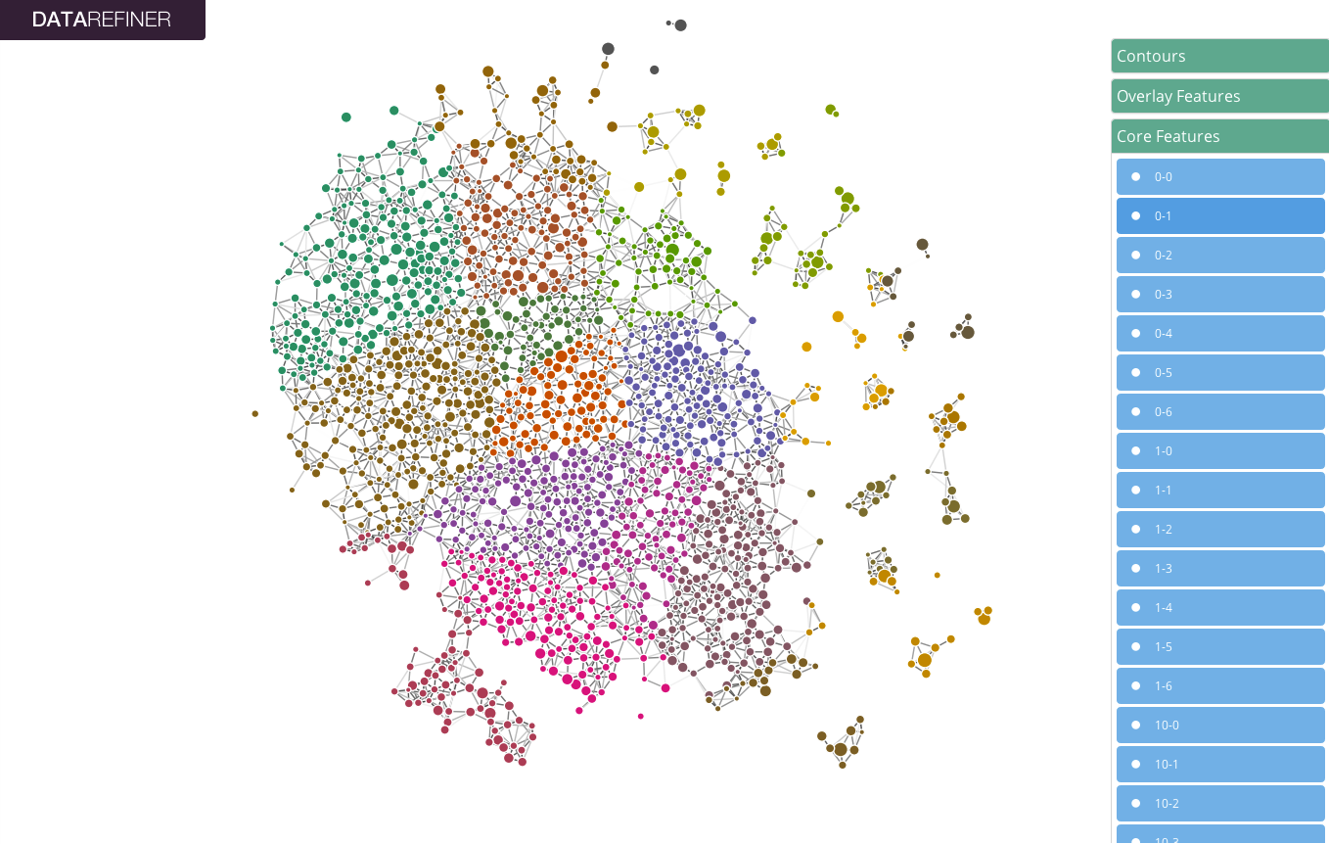
Live Demo

Slide 29
Links
Topology And Data (Gunnar Carlsson):
http://www.ams.org/journals/bull/2009-46-02/S0273-0979-09-01249-X/S0273-0979-09-01249-X.pdf
Discrete Morse Theory and Persistent Homology (Kevin P. Knudson):
http://www.math.fsu.edu/~hironaka/FSUUF/knudson.pdf
Topological Persistence and Simpliﬁcation
(Herbert Edelsbrunner, David Letscher, Afra Zomorodian):
http://math.uchicago.edu/~shmuel/AAT-readings/Data%20Analysis%20/PersTop.pdf
Netflix Diagram (3200x3200):
http://datarefiner.com/netflix17770movies.png
Netflix Diagram with movie titles (17000x17000, 86MB):
http://datarefiner.com/netflix17770movies_annotation.png

Slide 30

Please sign up for free beta access:
www.datarefiner.com
info@datarefiner.com

